Slide 1
Data Warehousing SS ZG515
PC Reddy
Guest Faculty – WILP, BITS Pilani

Slide 2
Data Warehousing – Lecture 7
ETL Processing & Aggregates

Slide 3
Lecture 7 Outline
Review Lecture 6, ETL processing
Review ETL code examples.
Aggregate Fact Tables
SnowFlake Schema

Slide 4
ETL Processing
ETL Process
DIM 1
Fact
Source
Staging
DIM 2
DIM 3
Process of loading Data into Data Mart

Slide 5
BI/reporting Process
1:M
DIM 1
1:M
Fact
1:M
DIM 3
DIM 2

Slide 6
ETL Processing
* Review ETL processing
* ETL code examples

Slide 7
The “Classic” Star Schema
A relational model with a one-to-many relationship between dimension table and fact table.
A single fact table, with detail and summary data
Fact table primary key has only one key column per dimension
Each dimension is a single table, highly denormalized
Benefits: Easy to understand, intuitive mapping between the business entities, easy to define hierarchies, reduces # of physical joins, low maintenance, very simple metadata
Drawbacks: Summary data in the fact table yields poorer performance for summary levels, huge dimension tables a problem

Slide 8
Need for Aggregates
Sizes of typical tables:
Time dimension: 5 years x 365 days = 1825
Store dimension: 300 stores reporting daily sales
Production dimension: 40,000 products in each store (about 4000 sell in each store daily)
Maximum number of base fact table records: 2 billion (lowest level of detail)
Each Brand has 500 products
Transactions are stored by product/store/week.
A query involving 1 brand, all store, 1 year: retrieve/summarize over 7 million fact table rows.

Slide 9
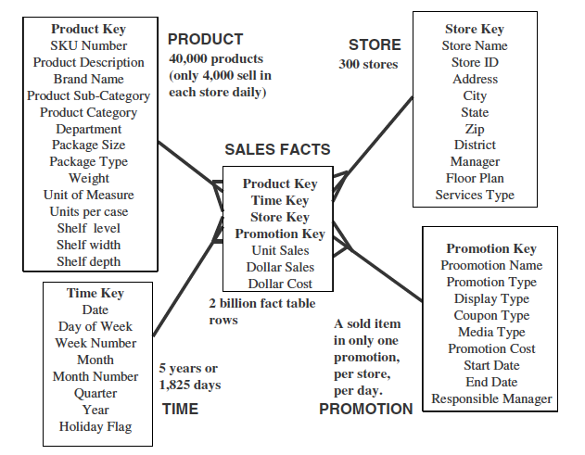
Need for Aggregates
Total Possible Rows = 1825 * 300 * 4000 * 1 = 2 billion

Slide 10
Aggregating Fact Tables
Aggregate fact tables are summaries of the most granular data at higher levels along the dimension hierarchies.
Hierarchy
levels
Product key
Product
Category
Department
Store key
Store name
Territory
Region
Product key
Time key
Store key
Unit sales
Sale dollars
Time key
Date Month
Quarter
Year
Multi-way aggregates:
Territory – Category – Month
(Data values at higher level)

Slide 11
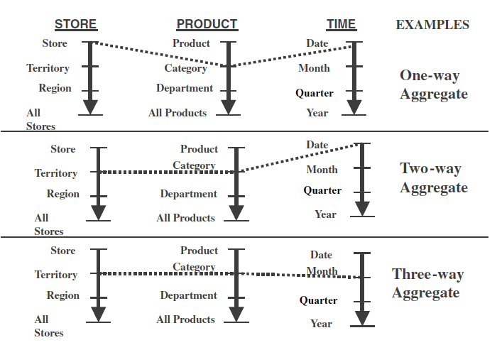
A way of making aggregates

Slide 12
Aggregate fact tables
District Fact Table
District_ID
PRODUCT_KEY
PERIOD_KEY
Region Fact Table
Region_ID
PRODUCT_KEY
PERIOD_KEY
Region_ID
PRODUCT_KEY
PERIOD_KEY
Dollars
Units
Price
Dollars
Units
Price

Slide 13
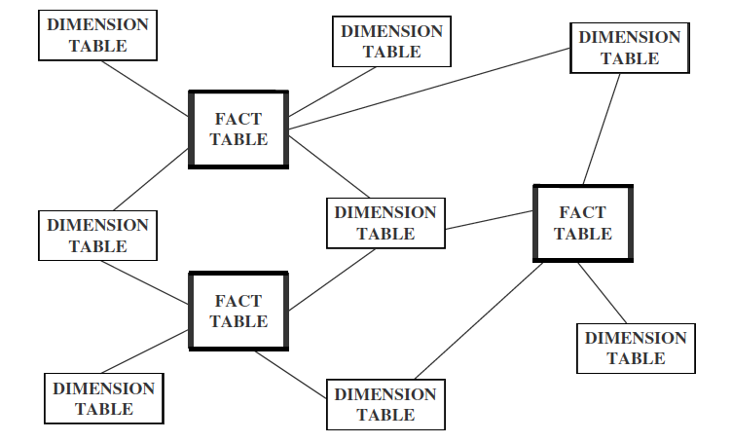
Families of Stars

Slide 14
Snowflake Schema
Snowflake schema is a type of star schema but a more complex model.
“Snowflaking” is a method of normalizing the dimension tables in a star schema.
The normalization eliminates redundancy.
The result is more complex queries and reduced query performance.
Reasons:
To save storage space
To optimize some specific quires (for attributes with low cardinality)

Slide 15
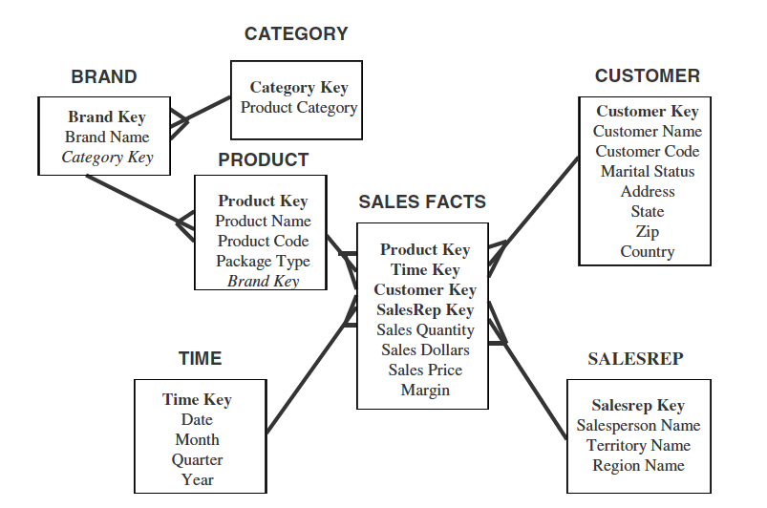
Snowflake Schema

Slide 16
Snowflake Schema
The attributes with low cardinality in each original dimension table are removed to form separate tables. These new tables are linked back to the original dimension table through artificial keys.
Product key
Product name
Product code
Brand key
Brand key
Brand name
Category key
Category key
Product category

Slide 17
Snowflake Schema
Advantages:
Small saving in storage space
Normalized structures are easier to update and maintain
Disadvantages:
Schema less intuitive and end-users are put off by the complexity
Ability to browse through the contents difficult
Degrade query performance because of additional joins

Slide 18
What is the Best Design?
Performance benchmarking can be used to determine what is the best design.
Snowflake schema: easier to maintain dimension tables when dimension tables are very large (reduce overall space). It is not generally recommended in a data warehouse environment.
Star schema: more effective for data cube browsing (less joins): can affect performance.

